Slide 1
Child abuse - I
Dr. I. Kitulwatte

Slide 2
Objectives
Should be able to
Name various forms of child abuse
Define physical and sexual child abuse.
List the circumstances of child abuse
Identify the main clinical features of child abuse.
Identify common conditions mimicking child abuse.
List the ways of presentation of child abuse.
Know how to investigate a case of child abuse

Slide 3
What is child abuse?
A child is said to be abused if he or she is treated in a manner that is unacceptable in a given culture at a given time
Meadow R, Epidemiology, in ABC of Child Abuse 3rd edi pp 1-4
Child abuse syndrome exists when an infant or child suffers repetitive physical injuries inflicted by a parent or guardian in circumstances that exclude accident.
Bernard Knight, Pekka Saukko, Fatal Child abuse in Knight’s Forensic Pathology, 3rd Edi, pp 461-479

Slide 4
What is child abuse?
Child abuse or maltreatment constitutes all forms of physical and or emotional ill treatment, sexual abuse, neglect or negligent treatment or commercial or other exploitation, resulting in actual or potential harm to the child’s health, survival development or dignity in the context of relationship of responsibility trust of power
WHO Handbook for medical officers 1999

Slide 5
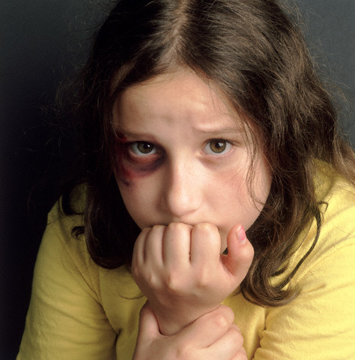
Types of child abuse
Physical
Sexual abuse
Child labour
Neglect
Emotional abuse

Slide 6
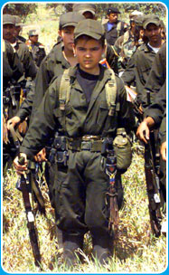
Types of child abuse cont..
Exploitation [use of child’s activities on the benefit of the others]
Conscription of children in armed conflict
Munchausen’s syndrome by proxy
Intentional poisoning

Slide 7

Iceberg phenomenon of child abuse
Endemic for generations
Hidden - small percentage is apparent
“seen” by the society are the complaints and detections by concerned adults.
Apparent abuse cases - would be denied

Slide 8
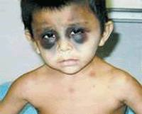
Physical child abuse
Deliberate infliction of physical injuries by parent, guardian or caretaker.
Usually short term and violent and may be repetitive.

Slide 9
Circumstances
Under 3 years of age
Disputed paternity
Unwanted children
Adopted children
Alcoholics or drug addicts
Immature parents
Children with learning difficulties/hyper active
Parents themselves been abused in their childhood
Domestic servants

Slide 10
Abusers
Parents
Guardian
Consorts of either spouse
Baby sitter
Care takers

Slide 11
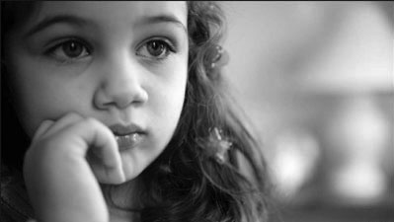
Suspicion and the confirmation based on
Delayed presentation
Untreated injuries
History- inconsistent
Demeanour of the child
Injuries that are typical

Slide 12
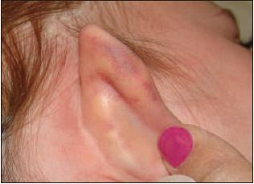
Classic sites of injuries
Ears (specially pinch marks)
Black eyes
Intra oral injuries
Triangle of safety (ears, sides of face, neck and top of shoulders)
Inner aspects of arms
Defense injuries in forearms

Slide 13
Classic sites of injuries cont..
Chest and abdomen
Back and sides of trunk (except bony prominences)
Groin and genital injuries
Inner aspects of thighs
Soles of foot

Slide 14
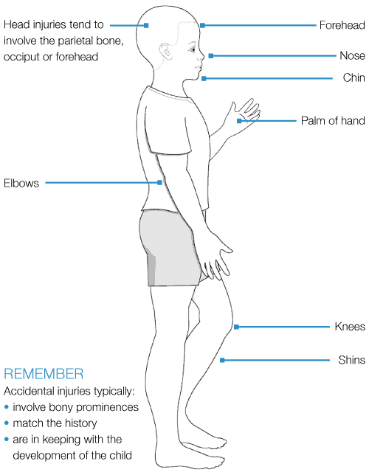
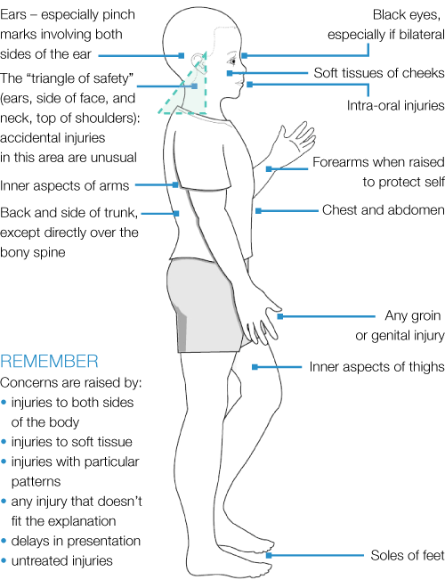
Typical sites of accidental injury
Sites arouse suspicion for abuse

Slide 15
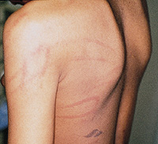
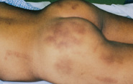
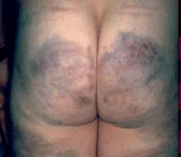
Classical injuries
Bruising in a young baby
Commonly small discoid bruises –finger pressure
Larger bruises - slapping or punching
Pattern injuries
Tramline contusions
Nail marks
Grip marks
Pinch marks
Age may be incompatible
Different ages of healing (recurrent episodes)

Slide 16
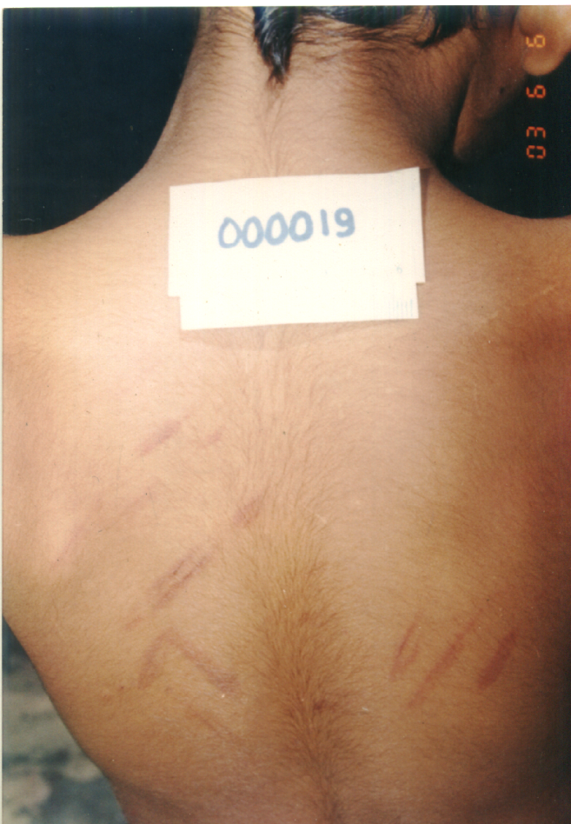
Tramline contusions
Pinching

Slide 17
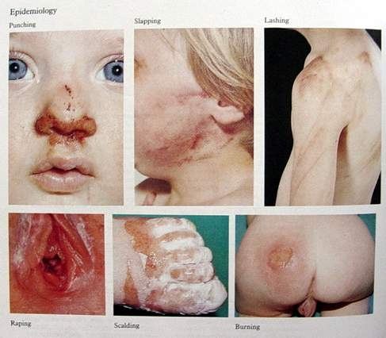
Various injuries

Slide 18
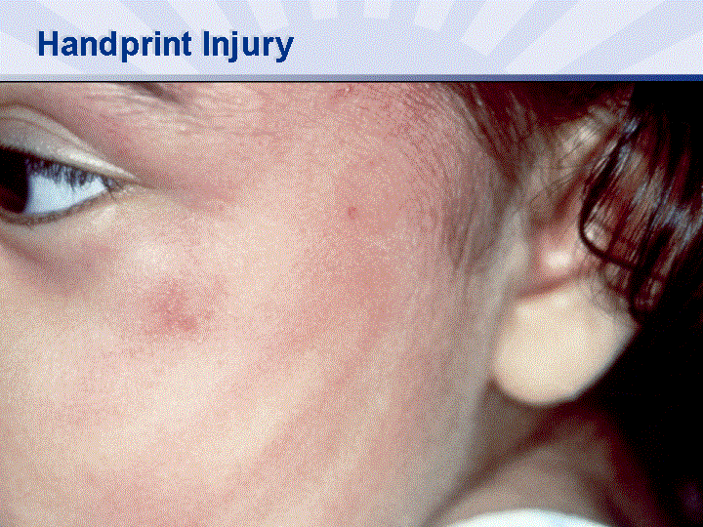
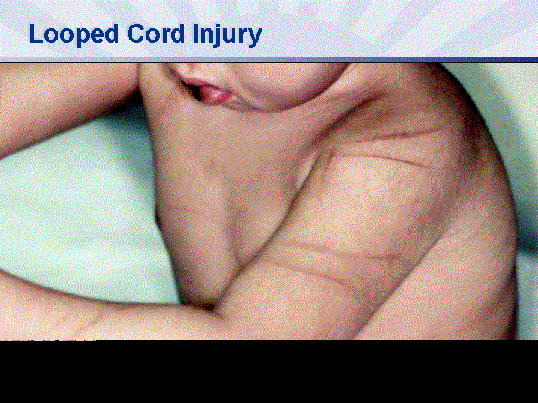
Slap mark
Lashing

Slide 19
Common sites of bruising
Specially wrists and forearms, upper arms, thighs, ankles in small infants (related to rough handling)
Buttocks –hand smacks /beating with straps
Thighs-
Inner side sexual abuse,
Outer side –slaps
Chest, abdomen and neck- from finger pressure
Face- cheeks and mouth from slaps

Slide 20
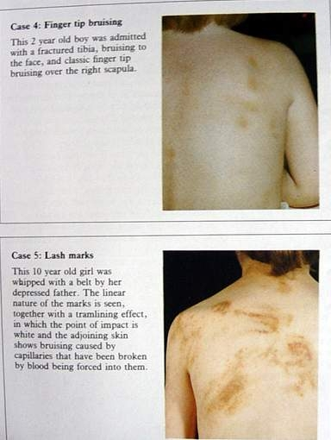
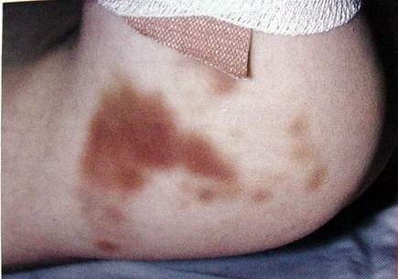
Bruises
Bruising in buttocks
Fingertip bruising and lashing

Slide 21
Fractures
Highly suspicious when seen in infants
Diagnosis by radiology
Dating is important
Need to exclude bone diseases (osteogenesis imperfecta, infantile cortical hyperostosis, congeneital syphilis, copper deficiency, Menke’s syndrome

Slide 22
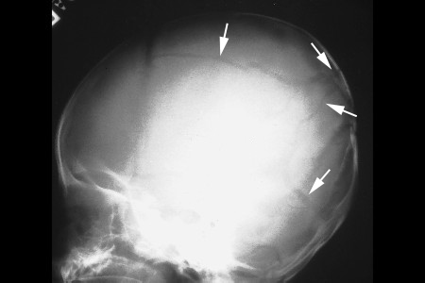
Common fractures
Skull:
Common in fatal child abuse
Associated with scalp injury
Could be single, multiple or depressed
Commonly in occipito-parietal area due to drops on vertex
Fracture lines usually ends at sutures
If crosses there is a lateral displacement

Slide 23
Skull fractures cont..
Blow /fall on the sides of the head
May see horizontal fracture running backwards extending towards to base of the skull.
Frontal fractures usually rare
Occipital fractures from falls on back
Suture ‘diastasis’ (with or without fractures)
Growing fractures - due to effects of raised intracranial pressure

Slide 24
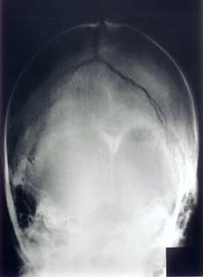
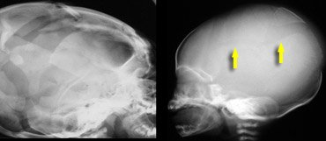
Skull fractures
Occipito parietal skull fracture
Suture diastasis

Slide 25
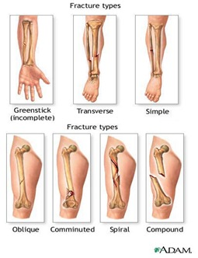
Long bones
Characteristic distribution and pattern
Most are indirect (abnormal angulations, torsion or traction)
Avulsion of the metaphysis or chipping of the edges of the metaphysis (Bucket handle)
Transverse or spiral fractures of long bones

Slide 26
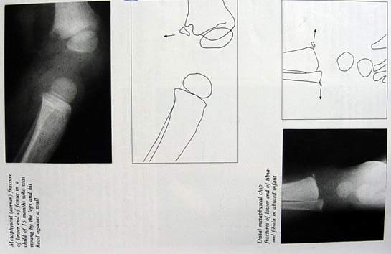
Metaphysial fracture

Slide 27
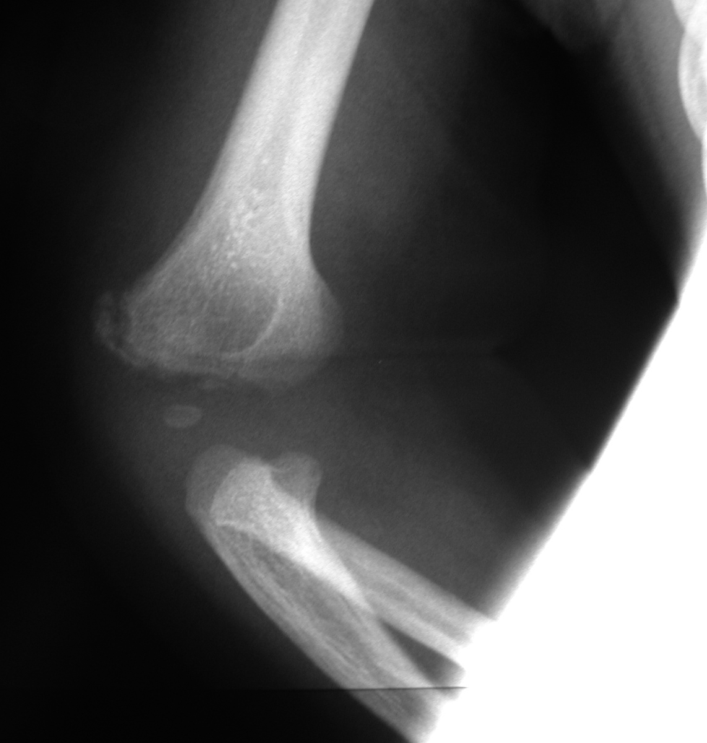
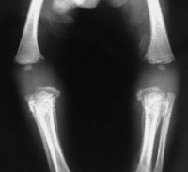
Bucket handle fractures

Slide 28
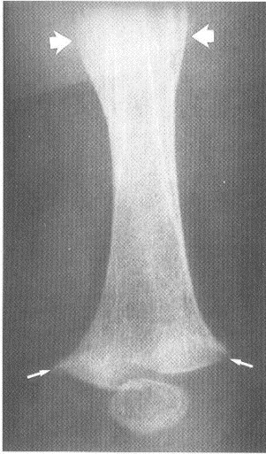
Long bones cont..
Fractures of different stages of healing
Epiphysial dislocation
Subperiosteal deposition of bone (periosteum is loosely attached lift with shearing or traction
Blood accumulate under the raised periosteum and calcify

Slide 29
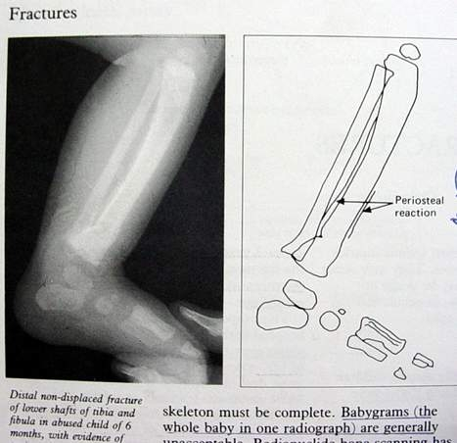
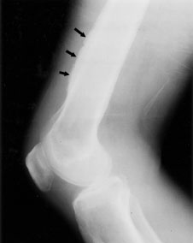
Periosteal new bone formation

Slide 30
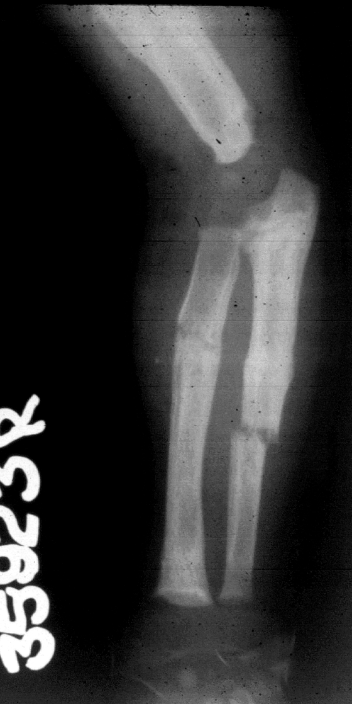
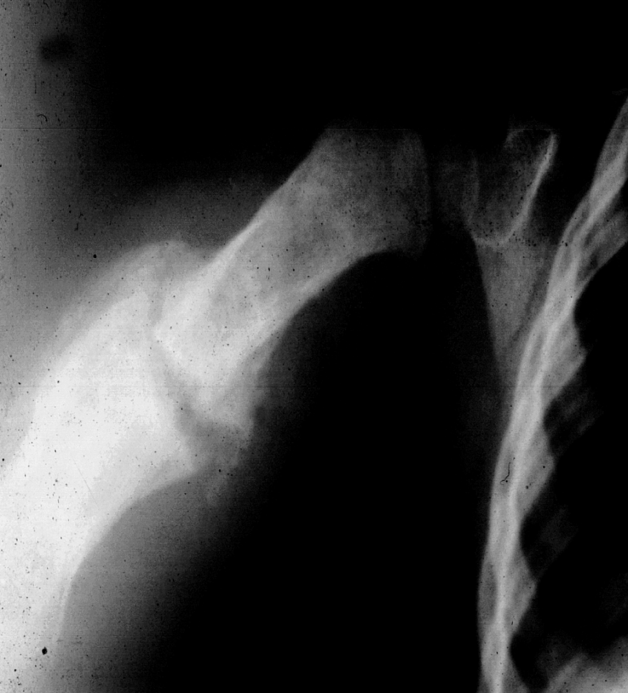
Healing fractures
Multiple fractures of different stages of healing

Slide 31
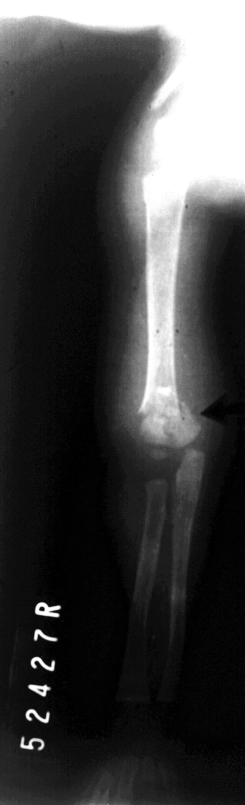
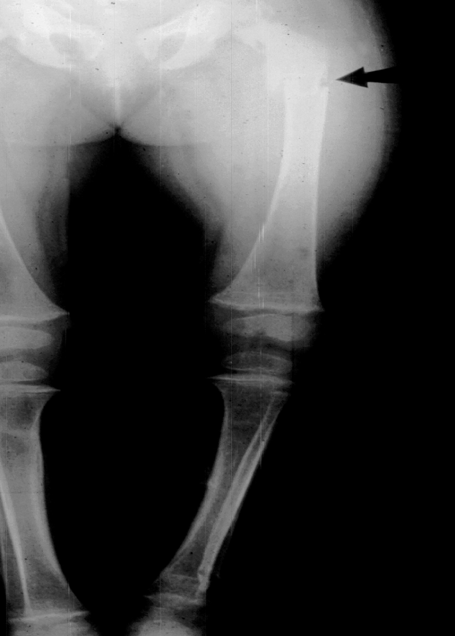
Supracondyler fracture of humerus
MULTIPLE FRACTURES OF LOWER LIMB

Slide 32
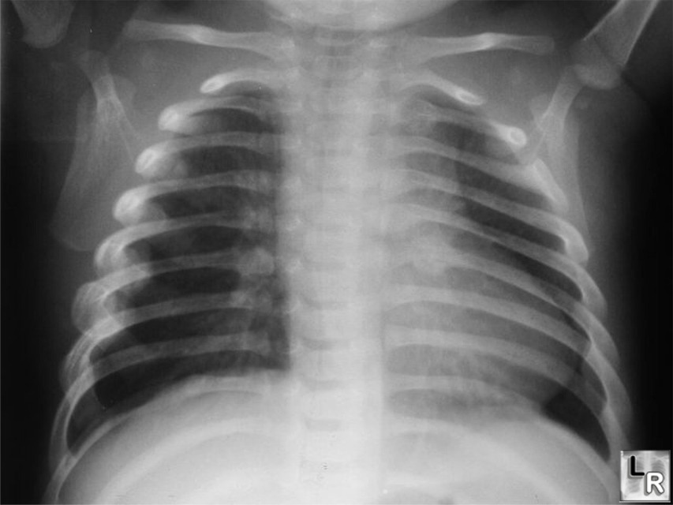
Rib fractures (string of beads)
From violent shaking while holding around chest or from antero-posterior compression
90% are in children < 2 years old
Ribs may fracture in posterior or lateral location (or both)
Initially not evident radiologically

Slide 33
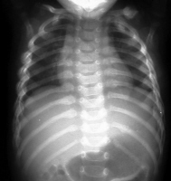
Rib fractures
Multiple rib fractures with callous
Posterior rib fractures appearing like a string of beads

Slide 34
Rib fractures (string of beads)
Callus formation enhances detection within 2 weeks
Appear like a string of beads
Need to exclude birth trauma and resuscitation related injuries in neonates

Slide 35
Severe head injuries in a baby or toddler
Most common form of fatal child abuse
Mechanisms
Direct blow
Chronic repetitive injury
Shaking (Controversial area)
Short falls

Slide 36
Injury pattern
Bleeding on (subdural/subarachnoid hemorrhage) or in brain, usually from a blow or with violent shaking alone
Subdural haemorrhage is from rupture of bridging vessels
Swelling (edema) of the brain in the contained space (the skull vault),
EDH rare

Slide 37
Eye injuries
Black eye, sclera and conjunctival haemorrhage are often seen
Direct violence can cause
bleeding into vitreous humour,
Lens dislocation
Retinal detachment
Retinal haemorrhage
Controversy exists over shaking and eye injury

Slide 38
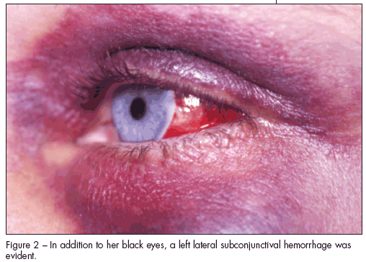
Black eye and sub conjunctival haemorrhage

Slide 39
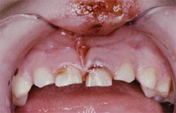
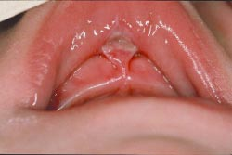
Lip injuries and torn frenulum
Common and is a characteristic sign of battered child
Mechanism is by slapping/forceful feeding and forceful closure of the mouth

Slide 40
Summary
Child abuse constitute any form of maltreatment or neglect caused by care givers resulting in actual or potential harm to the child.
Only a small percentage of existing child abuse is apparent in the society.
Delayed presentation, multiple injuries of different stages of healing arouse suspicion of child abuse.
Before confirming a case as child abuse natural and accidental conditions mimicking abuse has to be excluded.

Slide 41
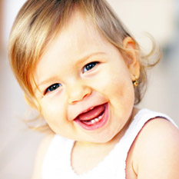
Thank you!

